Slide 1

National GST Enforcement Officer’s Conference
4th March, 2024
STATE TAX DEPARTMENT
GOVERNMENT OF UTTARAKHAND

Slide 2
Uttarakhand - Enforcement Structure
Commissioner, State Tax
Additional Commissioner, Garhwal Zone
Additional Commissioner, Kumaon Zone
JC-Enf/SIB,
Dehradun
JC-Enf/SIB,
Roorkee
JC-Enf/SIB,
Haldwani
JC-Enf/SIB,
Kashipur
1 SIB Unit
2 Mobile Units
1 SIB Unit
4 Mobile Units
1 SIB Unit
2 Mobile Units
1 SIB Unit
3 Mobile Units
CIU at HQ

Slide 3
Enforcement – 11 Mobile Units
Year | Amount deposited during road checking (In Cr)
2018-19 | 15.39
2019-20 | 23.29
2020-21 | 26.30
2021-22 | 38.25
2022-23 | 50.67
2023-24 (till Feb) | 70.10

Slide 4
Enforcement – 4 Special Investigation Branches (Search & Seizure)
Year | Number of Investigation Conducted | Evaded Turnover (In Cr) | Amount Deposited during investigation (In Cr)
2018-19 | 149 | 596.24 | 110.51
2019-20 | 155 | 1274.47 | 31.99
2020-21 | 166 | 436.60 | 32.62
2021-22 | 215 | 1094.97 | 11.25
2022-23 | 333 | 1441.47 | 37.43
2023-24 (till Feb) | 180 | 394.33 | 38.5

Slide 5
Enforcement – Centralized Investigation Unit
(CIU at HQ)
Year | Number of Investigation Conducted | Tax Evasion (In Cr) | Amount Deposited/ ITC Blocked/ ITC Reversed (In Cr)
2022-23 | 18 | 39 | 4.73 Accused convicted for 5 years
2023-24 (till Feb) | 30 | 32.52 | 16.55

Slide 6
EWB Generations and Verifications
FY | EWB Generations | Total Verifications | % Verifications | National Verification %
2021-2022 | 1,06,45,356 | 8,89,596 | 8% | 3%
2022-2023 | 1,28,38,854 | 8,86,617 | 7% | 2%
2023-2024 (till Jan) | 1,22,59,403 | 7,07,773 | 6% | 2%
Total | 3,57,43,613 | 24,83,986 | 7% | 2%
Source: EWB Dashboard

Slide 7
Major Cases
Major cases have been detected and investigated using various portals and analytics tools such as Boweb, BIFA-GAIN, EWB-Analytics, EWB-MIS, and GST Prime.
Investigations have been conducted against:
Manpower Suppliers (Conviction) (2022-23)
Timber Traders (Arresting) (2023-24)
Hotels and Restaurants (2023-24)
Pharmaceutical Manufacturers and Traders (2023-24)
Bitumen Oil Manufacturers and Traders (2023-24)
Financial Sector (Banking and Insurance) (2022-23)
7

Slide 8
Conviction in Manpower Supplier case
(2022-23)
High ITC Utilization
Purchase/ Sale
EWB RFID analysis
Vehicle analysis on VAHAN portal
  Firms earlier setting off their liability through cash but were later setting off their liability majorly through ITC.
  Firms were showing purchase and sale of iron, plywood etc. from firms registered in Delhi, Haryana & UP and Punjab & Maharashtra respectively.
  Certain vehicles were either not crossing any toll or were on different route at the time.
  Certain vehicle entered in the EWB did not have the capacity to transport the quantity of goods shown in the EWB.
Evasion
Authorization for arrest
Conviction
  Firms had wrongfully availed and utilized ITC of ₹ 17.01 Cr using fake invoices.
  ₹ 2.23 Cr was deposited by beneficiaries.
  Issued by Commissioner, State Tax.
  Accused was arrested on 05.04.2022 and complaint was filed against him on 02.06.2022.
  Accused was sentenced to 5 years rigorous imprisonment on 19.12.2022 by Hon’ble Chief Judicial Magistrate, Haridwar

Slide 9
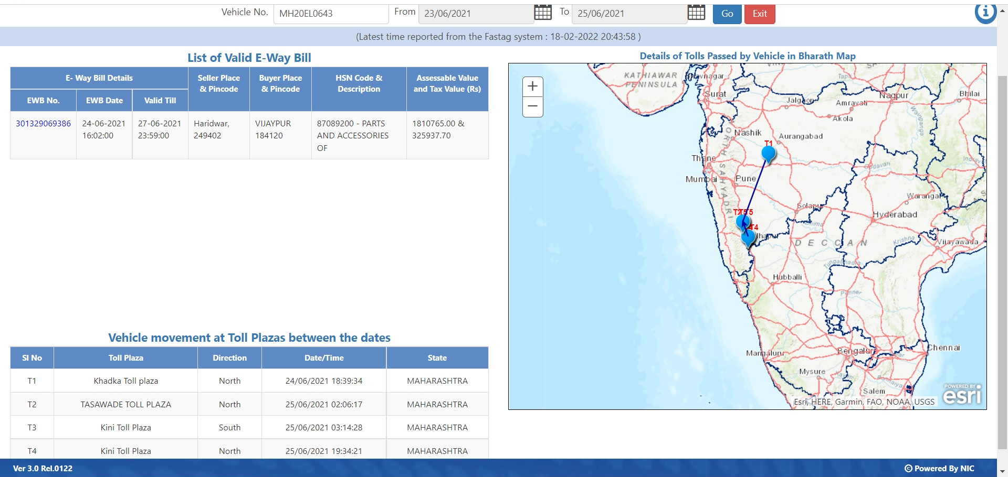

Slide 10
Arresting in Timber case
(2023-24)
On examination of a newly registered firms dealing in timber generating high value of EWBs, it was found that the firms were operating as a network to pass on fake ITC through bill trading.
Search and seizure was conducted at 25 places including place of business and residence of 15 firms, transporters, office of 01 Chartered Accountants and 5 Advocates.
Firms were found registered using documents of economically poor section of society by giving them monetary incentives.
Prima–facie tax evasion of ₹ 18 Cr was detected, and ₹ 3.26 Cr was recovered (including ₹ 53 lakhs ITC reversal). Mastermind was arrested on 22.10.2023 and chargesheet has been filed against him.

Slide 11
Bill Lao Inam Pao (BLIP) Yojana
Scheme instituted to create awareness and incentivize people to get bills for their purchases.
Launched in September, 2022 and has been extended up to March, 2024.
Under the scheme, 1500 prizes will be given every month.
Under the scheme, 77,471 registered users have uploaded 4,84,251 bills covering value of ₹ 214.41 Cr till Jan ’24.
Mega Lucky Draw will be held after March, 2024

Slide 12
Cases identified using BLIP
(2023-24)
Investigation against restaurants declaring nil GST turnover but high number of bills uploaded in BLIP app.
Investigation against hotels not filing return but having bookings through E-Commerce websites.
22 such hotels and restaurants were surveyed involving tax evasion of ₹ 18.89 Cr.
₹ 81.82 lakhs was deposited till Jan, 2024

Slide 13
Major Cases – Pharmaceutical firms
(2023-24)
During analysis of the firms involved in pharma manufacturing and trading, it was found that majority of the supplier firms were cancelled/ suspended for reasons of firm being found non-existent or registration obtained by means of fraud and did not have any purchase backup
Many of these firms were setting off majority of their liability through ITC. E-way bill analysis showed that vehicles were not crossing toll or were on different route at the time.
VAHAN analysis showed that certain vehicles entered in the EWB did not have the capacity to transport the quantity of goods shown.
Search and seizure investigation was conducted against 9 firms. Prima-facie tax evasion of ₹ 6.4 Cr was detected.
₹ 1.11 Cr was recovered, ITC of ₹ 4.87 Cr was blocked and ITC of ₹ 16.17 lakhs was reversed.

Slide 14
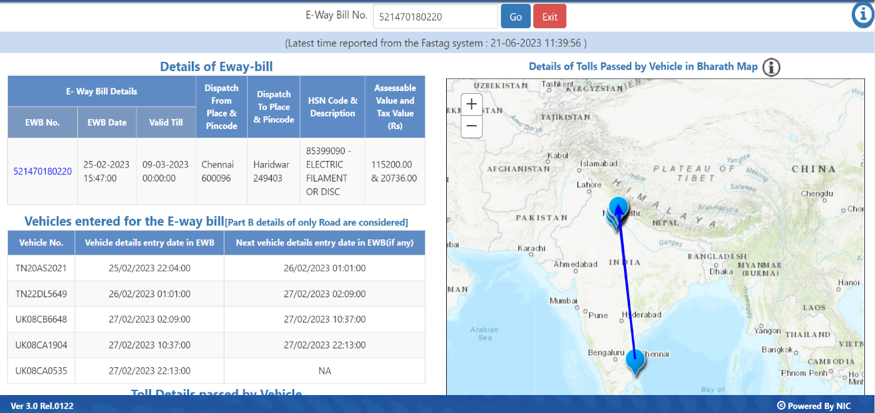

Slide 15
Major Cases – Bitumen Oil
(2023-24)
  During analysis of the firms involved in manufacturing and trading of bitumen oil, it was found that majority of the supplier firms were cancelled/ suspended for reasons of firm being found non-existent/ registration obtained by means of fraud and did not have any purchase backup
  E-way bill analysis showed that vehicles were not crossing toll or were on different route at the time.
  Prima-facie tax evasion of ₹ 11.15 Cr was detected.
  Search and seizure investigation was conducted against 12 firms at 16 locations.
  ₹ 1.82 Cr has been deposited till date and ITC of ₹ 2.47 Cr blocked.

Slide 16
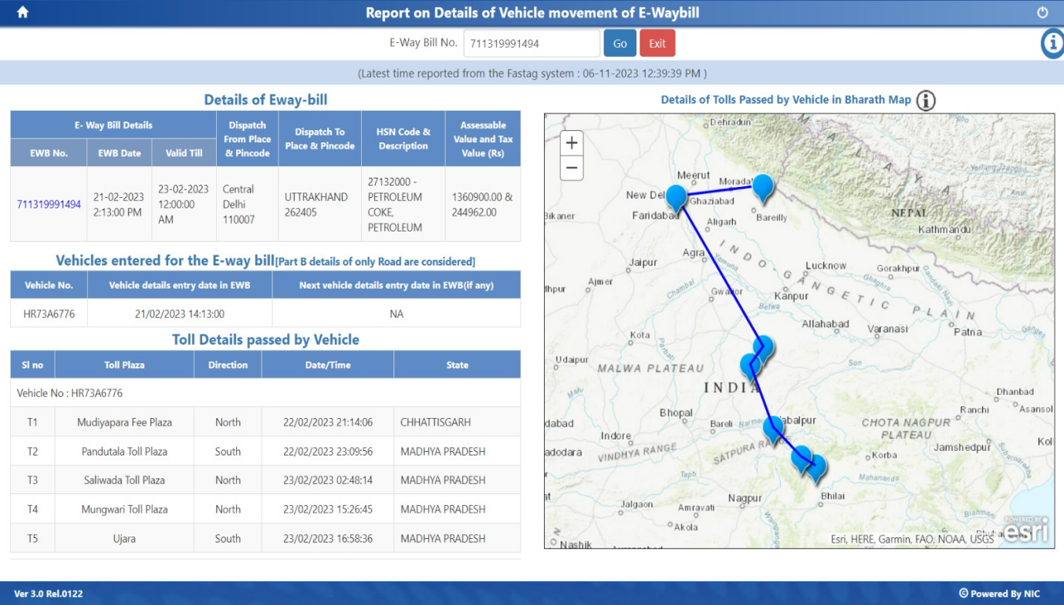

Slide 17
Major cases – Banking and Insurance
(2022-23)
Dedicated SIT was formed to study and analyse the banking and insurance sector.
During investigation, 15 banking and insurance sector firms claiming ineligible ITC were identified.
Demand of ₹ 108.20 Cr was created and ₹ 12.54 Cr has been deposited till date

Slide 18
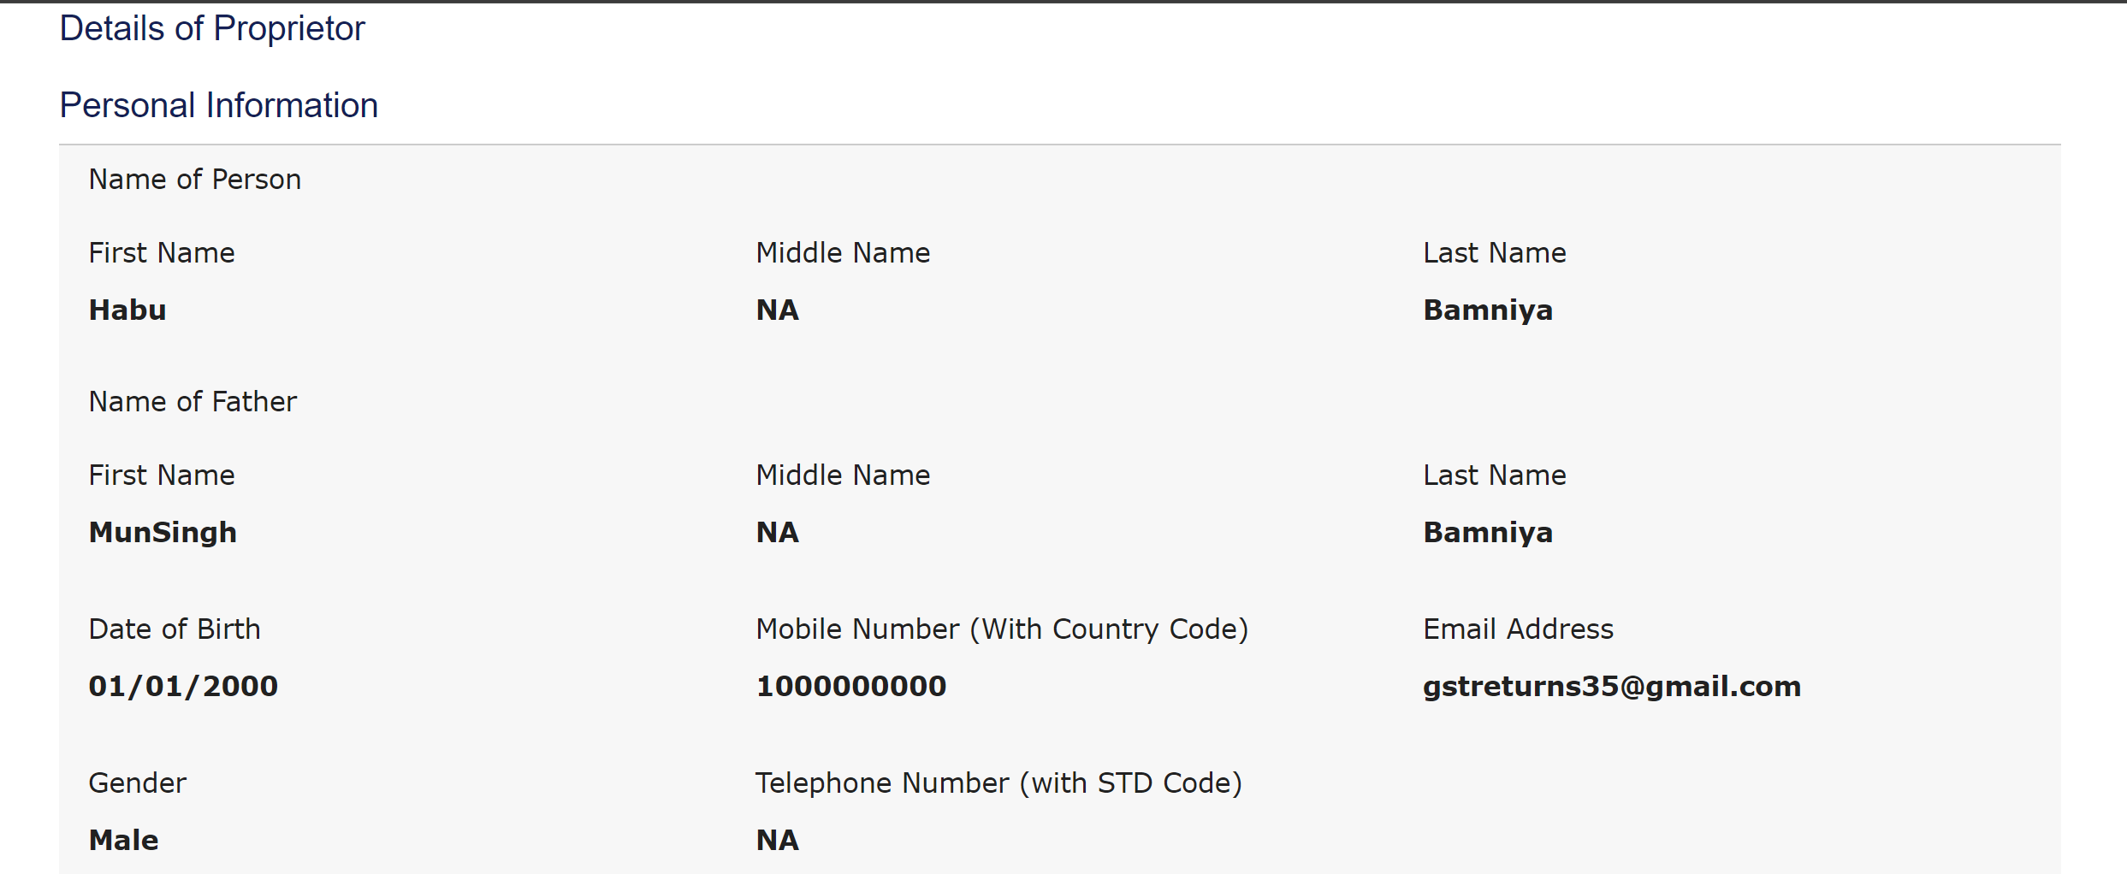
Challenges
Boweb portal should have OTP based verification for mobile no’s and email id’s entered at the time of registration to prevent fraudulent registrations.
Screenshot of Proprietor details of firm registered since April, 2023
18

Slide 19
Challenges
Integration with various agencies and databases such as:
  Exchange of information regarding firms registered in other States/ Central jurisdictions utilizing/ passing on fraudulent ITC through the centralized portal.
  Income Tax database so that list of all bank accounts linked to particular PAN can be accessed.
  Exchange of information regarding investigations/ Enforcement action conducted by other agencies
19

Slide 20
Challenges
Enforcement case id created against a GSTIN by CGST Officers is not visible to State Officers which leads to duplicacy of investigation.
BOweb Enforcement Module does not have the option to issue Show Cause Notice U/s 130.
Auction facility is not available for goods and vehicles seized U/s 130 during transportation.
Cross-jurisdiction ITC cannot be blocked and DRC-04 cannot be issued.
Immediate suspension/ ab-initio cancellation of active fake firms found during investigation is required.
Cases of restoration of registration of GSTINs which were cancelled ab-initio.
20

Slide 21
THANKS

