Slide 1

National Conference of Enforcement Chiefs
on issues in Enforcement and Best Practices
Commercial Taxes Department
Government of Andhra Pradesh
04-03-2024

Slide 2
Objectives of Enforcement wing
    Nurture Tax-compliance among Taxpayers.
    Better Targeting of the Cases to curb evasion.
    Avoid harassment to Taxpayers.
    Oversight on Tax-administration to prevent high-pitch demands.

Slide 3
Selection of cases for Enforcement
Data Analytics
  Taxpayer Level – Profile of the taxpayer is analyzed based on the tax paid and turnover particulars utilizing historical data.
  Sectoral Analysis – Profile of the taxpayer is analyzed through data modelling with respect to his sector.
Human Intelligence – Cases identified through local intelligence.
Based on Return Scrutiny – Cases identified through return scrutiny.

Slide 4
Analysis of taxpayers’ Profile
Registrations
Registration Alerts
GSTR-1 vs GSTR-3B TCS vs GSTR-3B Turnovers
TDS vs GSTR-3B Turnovers ITC Spike Analysis
Ineligible ITC / ITC Reversal Interest Liability
GSTR-3B vs GSTR-9
Returns
Sectoral
Low cash-to-liability ratio
Large B2C Transactions
Service Sector
ITC Restriction GTA with excess ITC claim
Profit Ratio Analysis under the Import & Export
Service Sector
E-way bills
E-way bills cancellations
E-way bills vs GSTR-3B
3rd party data
Turnover comparison

Slide 5
Effectiveness of Analytical Reports
S No | Analytical reports | No. of cases completed | Demand (In Crore) | False Positive | Strike rate %
1 | Registration | 54 | 18.23 | 28 | 65.86
2 | Returns | 2517 | 2361.73 | 252 | 89.99
3 | Sectoral | 65 | 5.2 | 8 | 87.69
4 | Service Sector | 201 | 189.95 | 26 | 87.06
5 | E waybills | 150 | 23.63 | 18 | 88.46
6 | 3rd Party Data | 7 | 10.74 | 1 | 85.71
 | Total | 2994 | 2609.48 | 333 | 88.88
 |  |  | Avg : 87 lakhs per case

Slide 6
Collections from Enforcement actions (since Oct’ 2022)
Inspections
Rs.433 Crores
Audits
Rs.202 Crores
Scrutiny of returns
Rs.254 Crores
Total Collections
Rs.889 Crores

Slide 7
Effectiveness of Analytical Reports based on Sectoral Analysis
Impact of 5 new Analytical Reports
Top Sectors’ Analysis
Top taxpayer analysis
Main Trading Partner Analysis
Inter-State Trade Quantum – E-Way Bill
IGST inflows and outflows
Action Initiated | Outliers identified
Return Scrutiny | 1600+
Audit | 700+
Inspection | 500+

Slide 8
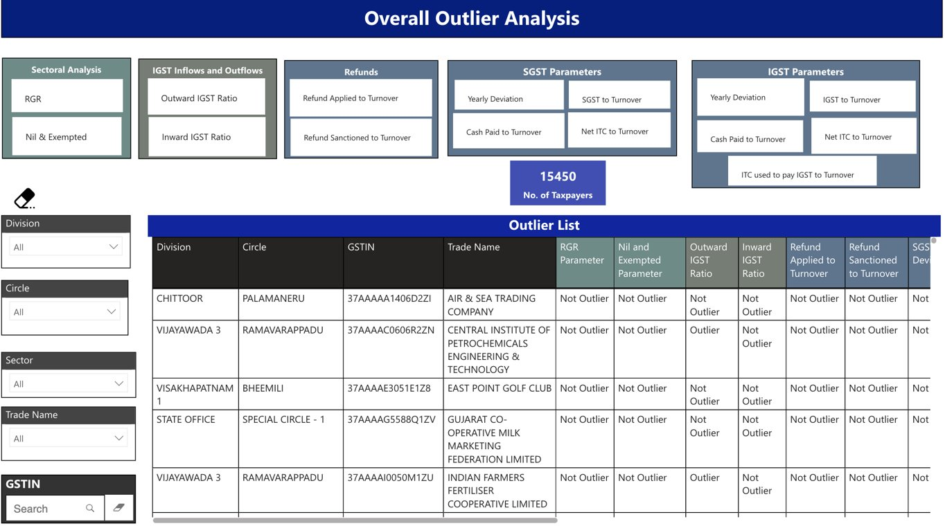

Slide 9

NGTP Modelling
The Non-Genuine Taxpayer report helps identify that are registered in the last 6 months and to take up required enforcement action.
Parameters for NGTP
State jurisdiction taxpayers
Newly registered TPs in the last 6 months are considered
Trade name as traders/enterprises included
Proprietor/Partnership concerns considered
Included TPs dealing in evasion-prone goods/services
Passing ITC of more than Rs.25 lakhs within 6 months of EDR
Exclude public/private limited and manufacturing units
Flags for NGTP
Aadhar authentication
Bank Account details not submitted
Number of RCs with the same PAN
Cash to Liability Ratio
Fake RCs with same PAN
1
1
1
1
  82 cases allocated
  42 cases closed
NGTPs
332Cr
Revenue Identified in closed cases
NGTP Model
0
0
0
0
0
From 2022 – till now
Execution
Genuine

Slide 10
State Monitoring Committee – Case selection and allocation
State Monitoring Committee – (SMC)
            Headed by the Chief Commissioner of State tax and 2 Senior officers of the department.
            Allocate cases based on combination of different parameters.
            Tasks are generated to the Proper Officers through online.
All enforcement actions are automated and processed through system.
Cases are referred based on outliers identified through analytical reports or human intelligence.
Information of the taxpayers for 32 parameters and mismatches send to SMC through online automated process.

Slide 11
Automated system for selection of cases 1/2
Step 1
Step 4
System automatically recommend the cases with required type of investigation based on the mismatches of the taxpayer data.
Cases referred by the field formations based on local intelligence are examined by the SMC and allocation also is done through online only.
Step 4
Step 5
Step 1
Step 2
Step 5
Selected cases will be integrated with the workflows and monitored in real time through APCTD executive dashboard.
State Monitoring Committee (SMC) will examine the cases and select the cases for investigation.
Step 3
Step 2
Step 3
Step 6
Step 6
Entire process of identification, selection and authorization is done through online.
SMC will allocate the cases to the authorized officer for further action.

Slide 12
Oversight on Enforcement Action
APCTD developed automated work-flow for all processes including Audits/ Investigations/ Return Scrutiny.
Every step of investigation is monitored on real time role-based dashboard.
Established State and Regional Investigation Monitoring Committees to examine the Investigation-findings arrived by the Proper officers to ensure uniformity and to avoid high pitch demands.
Based on threshold of the tax identified, cases are referred to the State (more than Rs.1cr ) or Regional Monitoring Committees (Rs.10 lakhs to Rs1Cr).
Committees periodically review the tax proposals for their legal validity and issue suggestions for any short fall in the findings etc.,
The cases are sent to the Proper officers with specific remarks of the committee.

Slide 13
Quality of Investigations
Avoidance of high pitch demands.
Ensure quality of enforcement actions - closely monitored through internal workflow and online system by checking effectiveness ratio reports.
Proper Officer enters the data after completion of each milestone in the process of investigations and scrutiny.
  For example: In Audit
    Audit ratio = Amount as per ADT02 + Amounts paid before ADT02 vs Discrepancy notice amount
    Adjudication ratio = Demand in DRC-07 Vs Demand proposed in ADT -02
    Collection ratio = Amount Collected vs demand raised
Similarly, measuring effectiveness ratios for inspections and scrutiny of returns.

Slide 14
Recovery
              Asset management module:
                Assets’ details of the defaulters are identified by integrating other govt department data bases (Property Tax, Land, RTA, Electricity).
                Movable assets (vehicles) and immovable assets (agricultural lands, plots and sites etc.,) of the defaulters are identified in real time.
                Recoveries made: 387 Cr (since Oct’ 2022) against 1716 Cr of collectable demand
                Prosecution ordered in 9 cases.
                Arrest provision is sparingly used.
                Fake registration racket dealing in granites and Iron Scrap was busted.
                Arrested 5 kingpins in the said racket.

Slide 15
Issues in Enforcement to achieve the core objective
    Sankalan : Modus operandi of DGGI cases may be shared with States
    Additional Data required to develop effective Data Analytics/Modelling – e-Invoice data, ICEGATE, Toll Plaza data, AS26, other State’s data (wherever required).
    Need for continuous capacity building: Knowledge on the implementation of GST for tax officers is not comprehensive.
    Need for training on collection of Human intelligence by DGGI

Slide 16
Thank You

