Slide 1

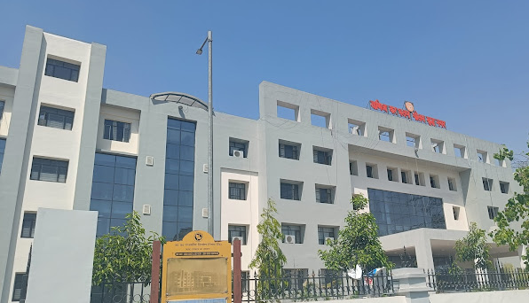
PRESENTATION BY GAUTAMBUDH NAGAR
ZONE : NOIDA

Slide 2

Mobile Equipment & Electronics
As per Economic Survey 2022-23, the domestic electronics industry was valued at $118 billion as of FY20 with its growth led by consumer electronics and industrial electronics.

Slide 3

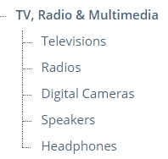
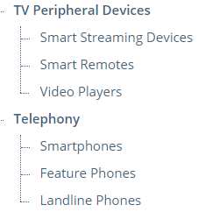
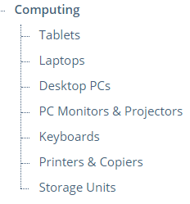
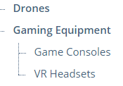
What are Consumer Electronics?
Consumer electronics (CE) refers to electronic devices designed to be purchased & used by end users or consumers.
A Bank of America report said that India consumed $158 billion worth of electronic goods in FY-2023 but majority of supplies were largely met by imports ($77 billion in FY23), and electronics is the second-largest import bill representing a fifth of the country’s trade deficit.
However, the PLI scheme will help in India’s efforts to cut imports and step up exports, and reduce the current account deficit by $112 billion over five years

Slide 4
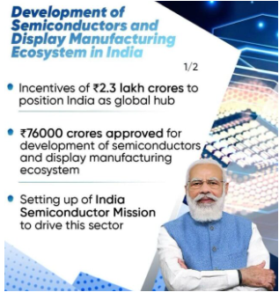
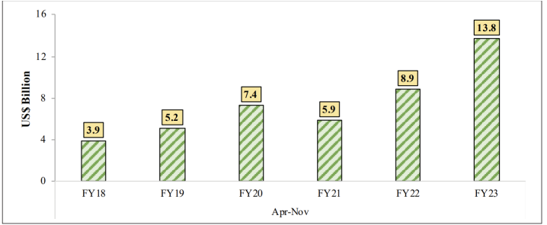
Robust Growth in Electronics
India aims to achieve electronics manufacturing worth $300 billion by FY26 as the country aspires to become a $1 trillion economy by 2025
Govt initiatives, such as the PLI scheme for Large Scale Electronics Manufacturing, DLI (Design linked incentive) scheme, & Scheme for promotion of manufacturing of electronic components and semiconductors (SPECS) are showing results.Cabinet has also approved the comprehensive development of a sustainable semiconductor and display ecosystem in the country with an outlay of Rs 76,000 crore.
Figure 1 : Growth of electronics exports, Source : DGCI&S

Slide 5
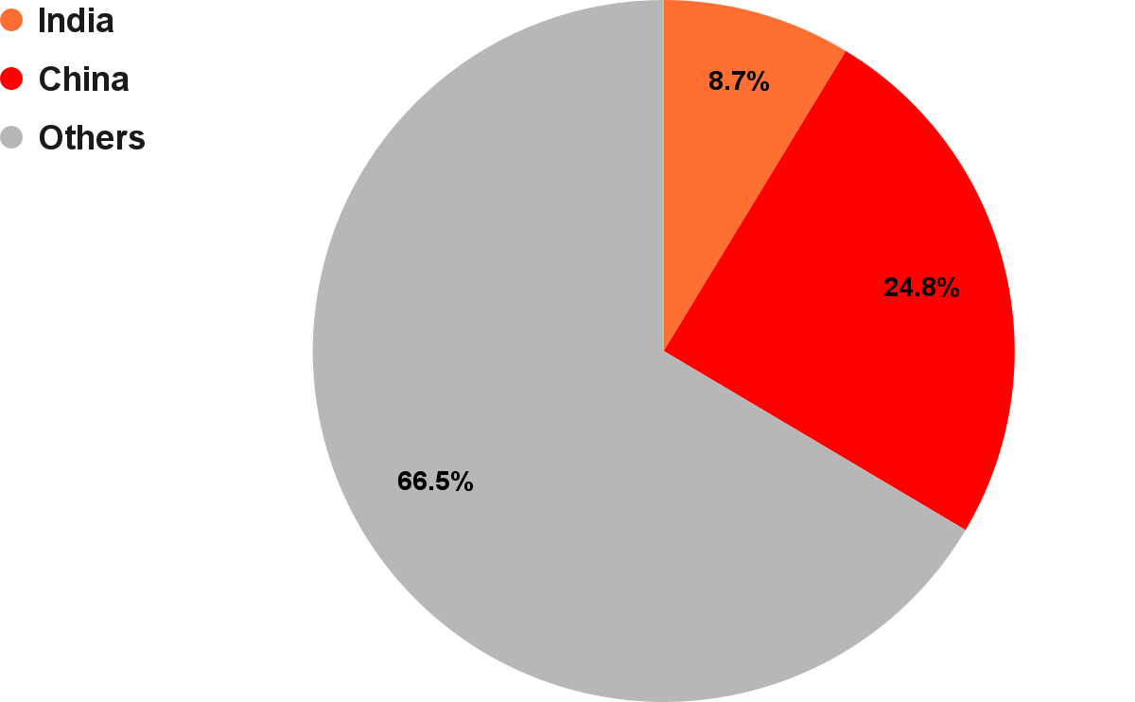

Smartphones
Smartphones are mobile devices that combine the functionality of a computer with the ability to make phone calls.
Features - Touch screen display, a camera, internet connectivity, GPS navigation, music playback, and the ability to run applications
Operating systems : Android, iOS, and Windows
In the Global Smartphones market, volume is expected to amount to 1.70 billion pieces by 2028
Key players in the global market : Apple, Samsung, Xiaomi, & Huawei - (known for innovative products & extensive distribution networks)
Smartphone Market | World | India | China
Revenue | $0.48tn | $41.74bn | $119.20bn
CAGR (2023-2028) | 2.54% | 7.20% | 1.92%

Slide 6
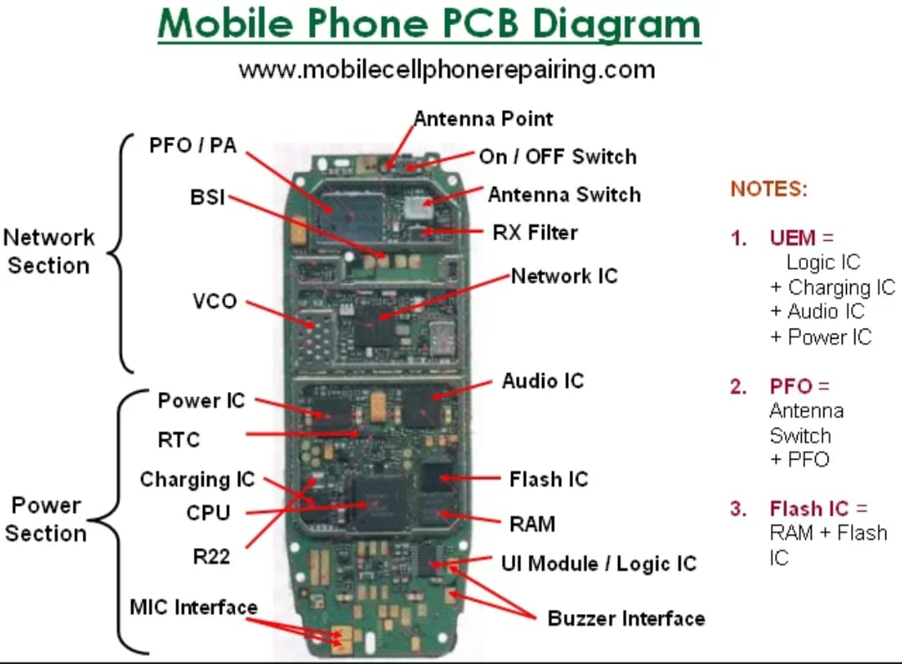
Components of Smartphones
A circuit board is the brain of the phone –
Printed Circuit Board (PCB) Assembly is responsible for connecting and controlling the various electronic components. Major ICs(Integrated Circuit) inside a Smartphone are:
  Antenna Switch
  P.F.O (Power Frequency Oscillator)
  RF IC / Hagar / Network IC
  26 MHz Crystal Oscillator
  VCO (Voltage Controller Oscillator)
  RX Filter and TX Filter
  ROM (Read Only Memory), RAM (Random Access Memory), Flash IC
  Power IC and Charging IC
  RTC (Real Time Clock / Simple Silicon Crystal)
  CPU
  Logic IC / UI IC and Audio IC
A liquid crystal display (LCD)
An antenna
A keyboard
A microphone
A speaker
A battery
Figure : Mobile phone PCB diagram divided in 3 main sections
Network Section - Antenna, External Antenna Socket, Radio Freq Crystal
Power Section – CPU, power IC, SIM is directly connected to CPU
Audio Section – Audio Integrated Circuit (IC)

Slide 7
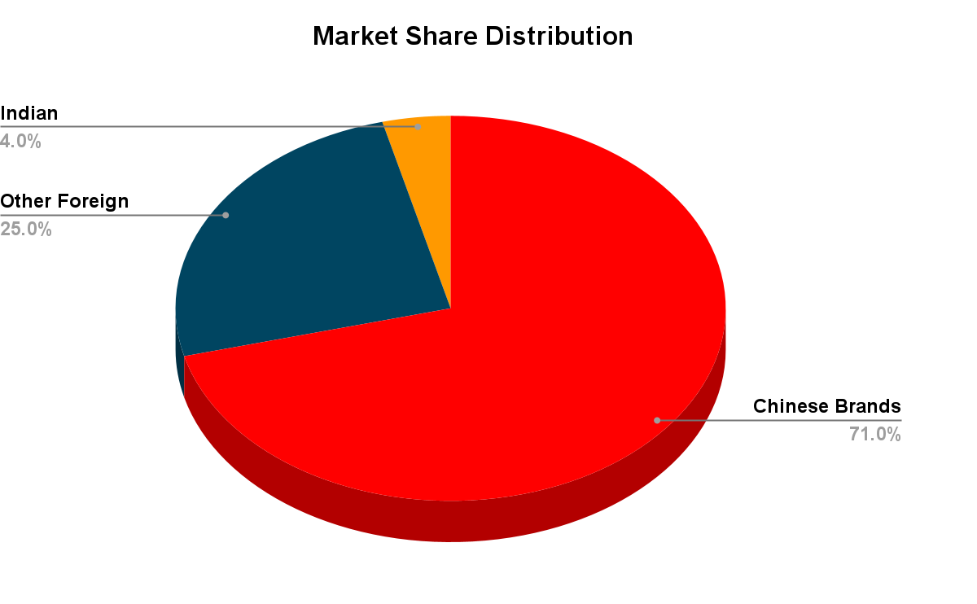
Indian Market Share of Smartphone Companies - I
According to a Frost & Sullivan report Indian mobile phone market is forecast to generate Rs 2.4 trillion revenue by FY26, up from Rs 1.4 trillion in FY22, with CAGR(compound annual growth rate) of 14.5%.In terms of volume, the Indian mobile phone market will amount to 370mn units by 2026 (up from 255 mn units in FY 22) with CAGR of 9.7%.
Chinese brands, such as Xiaomi, Oppo, Vivo, Realme,& OnePlus, comprised 71% of the smartphone market share in India in FY22, while foreign (excluding China) & Indian brands accounted for the remaining 25% and 4%.
India's infrastructure, favourable government policies & large talented workforce have started attracting giant global corporations like Apple, Samsung etc

Slide 8
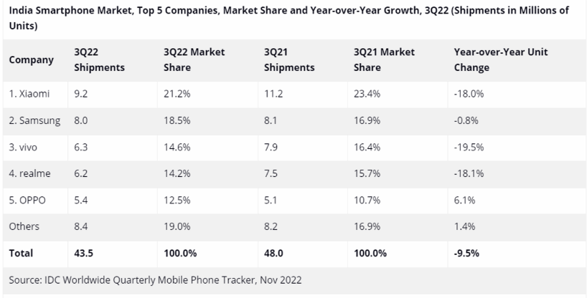
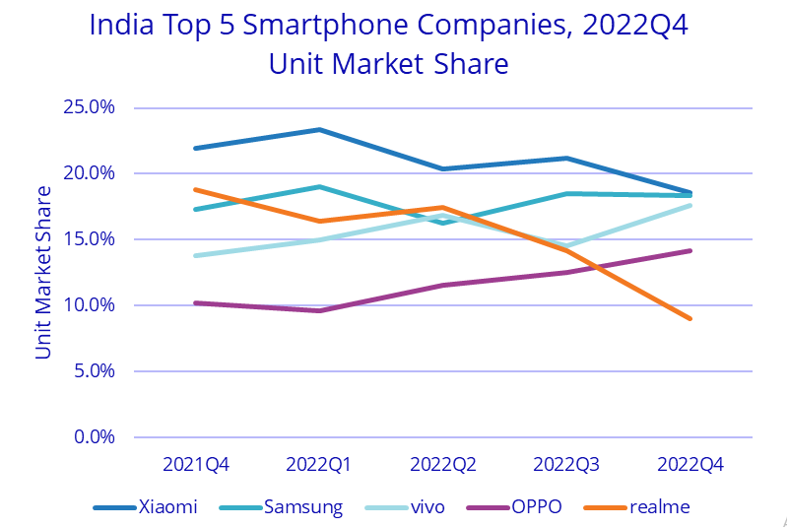
Indian Market Share of Smartphone Companies - II
As per, IDC’s Worldwide Quarterly Mobile Phone Tracker report, smartphone shipments dipped to a four-year low of 31 million in the first quarter and the overall smartphone market is expected to see a flat growth this year, FY 23. The decline in smartphone shipment has been mainly due to the weakness of demand in the sub-Rs 10,000 segment however demand in mid-range smartphones is expected to increase.
Source : International Data Corporation (IDC)

Slide 9
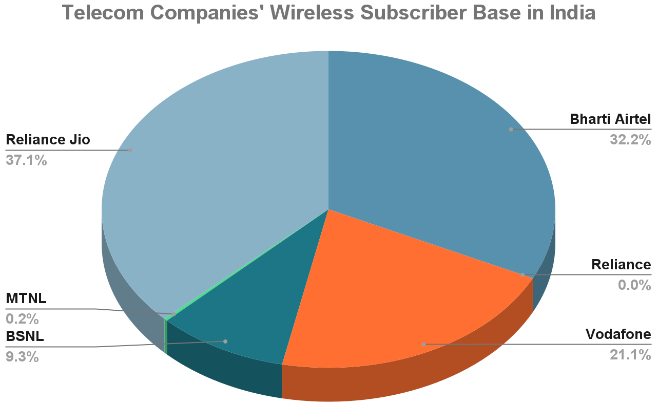
Telecom Sector
Telecommunication is a critical infrastructure sector, backbone to the Information Communication Technologies (ICTs) & Government programs like ‘Digital India’, ‘Smart Cities’ etc
Total telephone subscribers (both wired and wireless) have crossed 117 crore at the beginning of 2023, providing huge opportunities for manufacturing telecom equipment(both wired and mobiles) in India for Indian population.
The launch of 5G services according to Economic survey is a landmark achievement. Rollout of 5G services will unleash new economic opportunities and help India leapfrog the traditional barriers to development, spur innovation by start-ups and business enterprises
Telephone Subscriber base as on 31st December, 2022
Wireline segment | Wireless segment
2.7cr (2,74,54,827) | 114.29 cr (1,14,29,25,233)
Source : Telecom Regulatory Authority Of India Press Release Feb ‘23

Slide 10


Hyper Growth of Indian Smartphones
“Growth of mobile industry from two manufacturers to 200 manufacturers is a living example of success''
-Cabinet Minister, Piyush Goyal
Growth
India surpassed $10 bn worth of mobile exports in FY 22-23 with potential to export mobile phones worth $100 billion and components worth $40 billion by FY26
As per a Bank of America report, PLI scheme for mobile phones can help India meet its ambitious target to triple its domestic production to $126bn and achieve 5 times growth in exports to $55 bn
As per India Cellular and Electronics Association (ICEA), Indian mobile brands are performing remarkably well, they produce efficient battery chargers along with meticulous cost effective phone designs
Performance
India-manufactured phones are popular in the Middle East and North Africa region
Indian electronics company LAVA, (well known handset manufacturer) has now become 1st Indian brand to launch a consumer 5G smartphone for the domestic market
Micromax, Lava, Intex and Karbonn are scripting success with low-cost phones

Slide 11

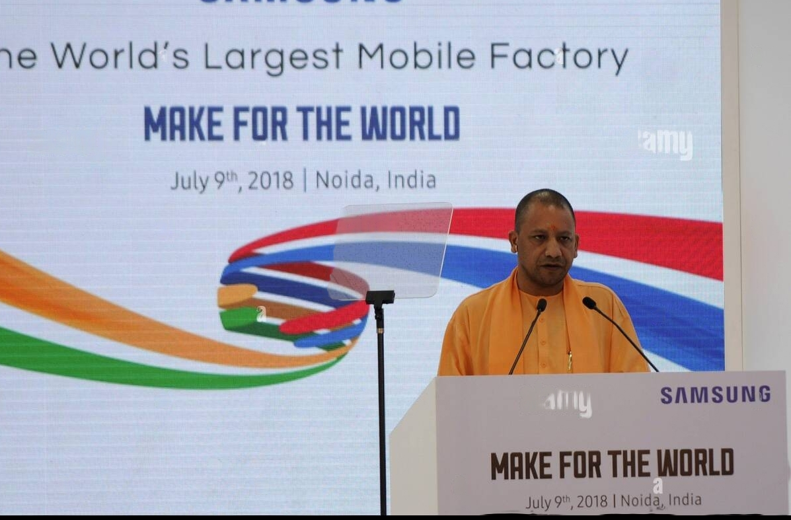
“Made in India”
Global Smartphones
India has become the second-largest mobile phone manufacturer globally, with production going up from 6 crore units in FY15 to 31 crore units in FY22.
Be it manufacturing, assembling or outsourcing, India has emerged as a top destination for mobile phone companies.
South Korean company Samsung has opened its largest factory in Noida
Government’s PLI scheme for mobile phones may drive Apple to shift at least 18% of its global iPhone production to India by FY2025. Apple already assembled its mobile in India through 3 of its global suppliers FOXCONN and PEGATRON in Tamil Nadu and WISTRON in Karnataka. Now it’s making iPhones under the banner of 'Make in India'

Slide 12
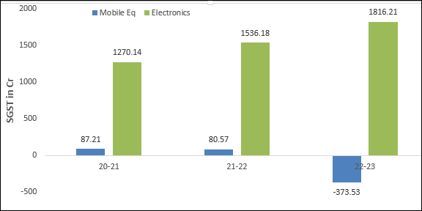
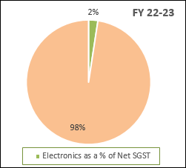
Share of Consumer Electronics in net State SGST
Revenue (Net SGST) Collection in Crores
Sector | Dealers | 20-21 | Share in State collection % | 21-22 | Share in State collection % | 22-23 | Share in State collection % | 23-24 (upto Jun 30) | Share in State collection %
Mobile Equipment | 68 | 87.21 | 0.15% | 80.57 | 0.11% | -373.53 | -0.50% | -233.74 | -1.15%
Electronics | 470 | 1270.14 | 2.18% | 1536.18 | 2.16% | 1816.21 | 2.41% | 534.40 | 2.63%
Total State Net SGST Collection (Including Compensation, IGST Adhoc) |  | 58180.92 |  | 71033.52 |  | 75412.99 |  | 20338.91
*Source: Business sector report of Top 15000 dealer MIS

Slide 13
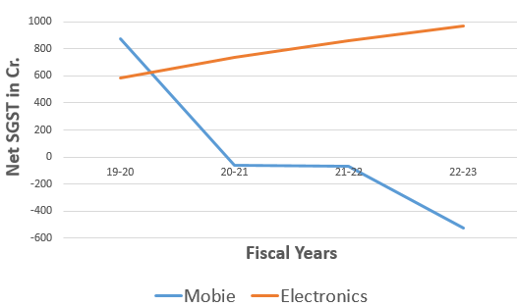
Consumer Electronics in Noida Zone
Revenue (Net SGST) Realized in Crores
Sector | No. of Dealers | 19-20 | 20-21 | 21-22 | 22-23 | 22-23(upto June ‘22) 23-24 (upto June ‘23)
Mobile | 26 | 874.57 | (-)64.80 | (-)67.88 | (-)524.1 | 132.25 (-)271.44
Electronics | 158 | 583.74 | 734.74 | 863.06 | 971.47 | 248.68 275.91

Slide 14
Turnover of Major Smartphone Companies in Noida

Slide 15
Turnover of Major Smartphone Companies in Noida

Slide 16
Turnover & GST Collection of Major Smartphone Companies in Noida
S.N | GSTIN | Firm Name |  | TURNOVER | IGST paid from SGST/UTGST ITC | SGST/UTGST paid from IGST ITC | Net IGST transferred | Cash deposited as SGST | Total collection (7+8)
1 | 09AAACS5123K1ZB | SAMSUNG INDIA ELECTRONICS PVT LTD | 2020-21 | 564213268368 | 2098581596 | 556856628 | -1541724968 | 1540888224 | -836744
 |  |  | 2021-22 | 491335632760 | 1918104725 | 517961644 | -1400143081 | 2071729641 | 671586560
 |  |  | 2022-23 | 603900334455 | 6636444893 | 386960451 | -6249484442 | 2266956158 | -3982528284
 |  |  | 2023-24 | 162595173963 | 1530815065 | 0 | -2054806044 | 712408060 | -1342397984
2 | 09AABCO9247K1ZX | OPPO MOBILES INDIA PRIVATE LIMITED | 2020-21 | 433046936891 | 3657852022 | 551615310 | -3106236712 | 195051899 | -2911184813
 |  |  | 2021-22 | 552675072960 | 3761537088 | 633297613 | -3128239475 | 424811975 | -2703427500
 |  |  | 2022-23 | 453366270126 | 803733599 | 2207643347 | 1403909748 | 223473774 | 1627383522
 |  |  | 2023-24 | 185585398198 | 7074552 | 3061917576 | 3054843024 | 207906 | 3055050930
3 | 09AAJCR1488F1Z2 | REALME MOBILE TELECOMMUNICATIONS INDIA PVT LTD | 2020-21 | 4953653 | 0 | 0 | 0 | 0 | 0
 |  |  | 2021-22 | 6720363999 | 0 | 0 | 0 | 0 | 0
 |  |  | 2022-23 | 42440126775 | 281840863 | 0 | -281840863 | 0 | -281840863
 |  |  | 2023-24 | 45406864651 | 3405740920 | 0 | -3405740920 | 0 | -3405740920
4 | 09AAECV8538M1ZJ | VIVO MOBILE INDIA PRIVATE LIMITED | 2020-21 | 285503075101 | 0 | 3942981821 | 3942981821 | 4563 | 3942986384
 |  |  | 2021-22 | 332278696057 | 0 | 5407558547 | 5407558547 | 0 | 5407558547
 |  |  | 2022-23 | 331684185998 | 186689071 | 759453460 | 572764389 | 581411 | 573345800
 |  |  | 2023-24 | 111241580954 | 603315061 | 0 | -603315061 | 185356073 | -417958988
5 | 09AAECV8538M2ZI | VIVO MOBILE INDIA PRIVATE LIMITED | 2020-21 | 128146662469 | 3479996060 | 0 | -3479996060 | 8818485 | -3471177575
 |  |  | 2021-22 | 190900246294 | 5815091057 | 0 | -5815091057 | 0 | -5815091057
 |  |  | 2022-23 | 196069791289 | 1784567767 | 0 | -1784567767 | 7266 | -1784560501
 |  |  | 2023-24 | 70033484235 | 680719421 | 0 | -680719421 | 0 | -680719421
6 | 09AAFCT8979H1ZI | ISMARTU INDIA PRIVATE LIMITED | 2020-21 | 47440060284 | 0 | 2856727888 | 2856727888 | 0 | 2856727888
 |  |  | 2021-22 | 71405813455 | 0 | 6022966903 | 6022966903 | 92880 | 6023059783
 |  |  | 2022-23 | 56528799699 | 0 | 4985675339 | 4985675339 | 333907 | 4986009246
 |  |  | 2023-24 | 28942812000 | 0 | 2498686688 | 2498686688 | 28981799 | 2527668487
7 | 09AAGCG5071N2Z3 | G-MOBILE DEVICES PRIVATE LIMITED | 2020-21 | 46232059624 | 2887733253 | 11926498 | -2875806755 | 2500000 | -2873306755
 |  |  | 2021-22 | 60329183580 | 4373088994 | 0 | -4373088994 | 37608 | -4373051386
 |  |  | 2022-23 | 48634577512 | 3754898387 | 0 | -3754898387 | 69864 | -3754828523
 |  |  | 2023-24 | 24717876327 | 1626820541 | 0 | -1626820541 | 0 | -1626820541
8 | 09AARCS8136R1Z5 | S-MOBILE DEVICES PRIVATE LIMITED | 2020-21 | 22647907513 | 1030633418 | 24657277 | -1005976141 | 7036452 | -998939689
 |  |  | 2021-22 | 26874025891 | 1700363399 | 0 | -1700363399 | 49811 | -1700313588
 |  |  | 2022-23 | 19018894185 | 1216199093 | 0 | -1216199093 | 112639 | -1216086454
 |  |  | 2023-24 | 9698120333 | 633932157 | 0 | -633932157 | 81602 | -633850555

Slide 17
Turnover of Companies in Q1 of FY 23-24 vs. FY 22-23

Slide 18




Tax Evasion by Smartphone Companies in India*
BRAND | CUSTOMS DUTY EVADED (In Cr.) | CUSTOMS DUTY RECOVERED (In Cr.) | GST EVADED (In Cr.) | GST RECOVERED (In Cr.)
XIAOMI | 682.51 | 10.76 | 168.63 | 82.04
 | 4403.27 | 476.79 | 683.04 | 738.04
 | 2875.00 | 117.00 | 48.25 | 51.25
 | NIL | NIL | 42.36 | NIL
*As per data presented by MoS for Electronics and Information Technology Sh. Rajeev Chandrasekhar in Rajya Sabha

Slide 19
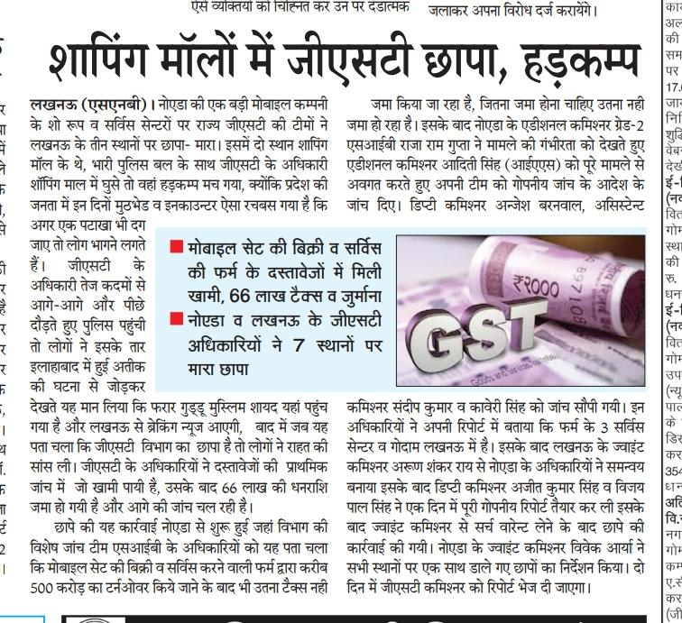
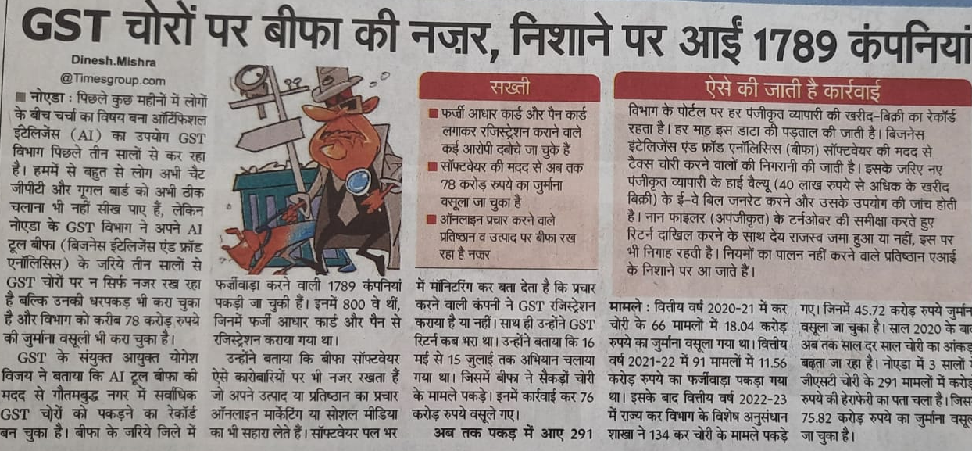
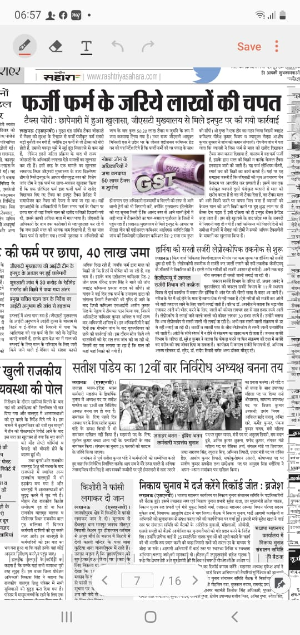
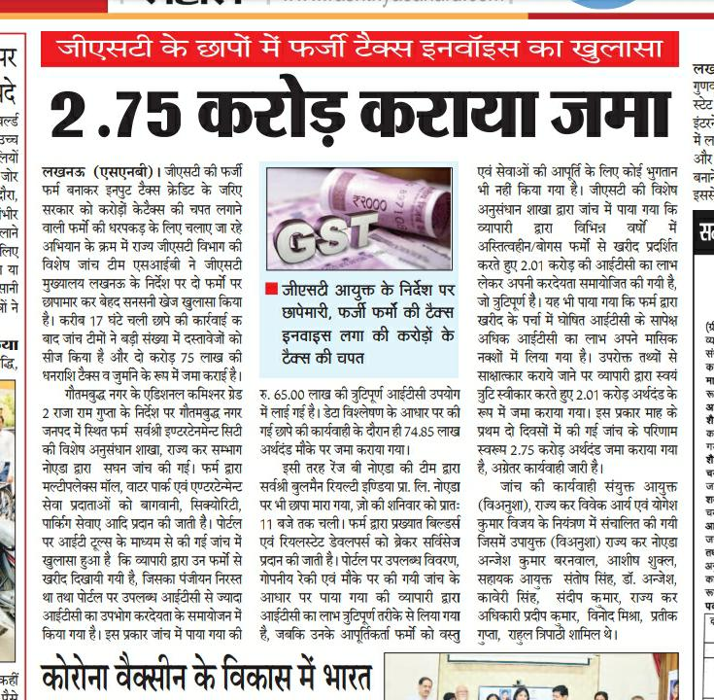
Performance of SIB Noida
Electronics | FY 22-23 | FY 23-24
Total Searches | 17 | 5
Evaded Tax Deposited | Rs. 1580.42 lakhs | Rs. 278.25 lakhs

Slide 20
Modus Operandi of Tax Evasion by Dealers - I
Under reporting of Income through Electronic Sales Suppression tools :
  Phantom ware (software that allows covert manipulation of sales data by business owner)
  Zappers (external device or program connected to cash register to delete and alter records)
  – Difficult to detect suppression of turnover as the data appears authentic.
  Solution : Counter suppression tools like Fiscal Memory Device, Sales Recording Module that use data recording technology to store transaction data in tamper proof form. These tools are used to send data automatically to Tax authority connecting cash registers online to data server systems.
False or fake invoicing to fraudulently claim expenses that have not been incurred for tax purposes –Verifying each invoice by comparing it to the records of the counterparty to the transaction is time consuming.
  Solution : Mandatory Electronic Invoicing.

Slide 21
Modus Operandi of Tax Evasion by Dealers - II
Correct liability not declared in returns (GSTR1-3B mismatch)
ITC taken for non business activities
Reversal of ITC not done in accordance with section 17(1),17(2) [Proportionate division of ITC for taxable and non-taxable activities]
Goods found in excess of purchases declared
Stock found short of declaration
Availing ITC from Bogus firms
Purchases below Rs. 50,000 to avoid compliance of E-way bill rules
Credit notes for previous period claimed
Discounts are given against section 15(3)(a & b) and in violation of GST Circular No. 92/11/2019 dt. 7/03/19 & 105/24/2019 dt. 28/06/19

Slide 22
Modus Operandi of Tax Evasion by Dealers - III
Manufacturing details in manual form to avoid necessary daily accounting in register
Sale of goods without E-way bills in small quantity & value; and invoice issued in fake names
Purchases of raw materials in cash
Wrong classification at the time of import to avoid appropriate duty
To avoid cash setoff, ITC is availed through circular trading without actual supply of goods
IGST on royalty is paid on RCM basis to offshore parent companies for use of brand name and chips. Deposit of 18% IGST on the basis of total turnover and consumption of chips is required
Software services from other countries attract IGST on RCM basis which may be verified through payment details

Slide 23
Thank you !

