Slide 1
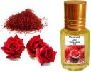
Perfumery and its Compounds
A presentation by:
Additional Commissioner Gr-I, State Tax,
Etawah Zone, Etawah.

Slide 2
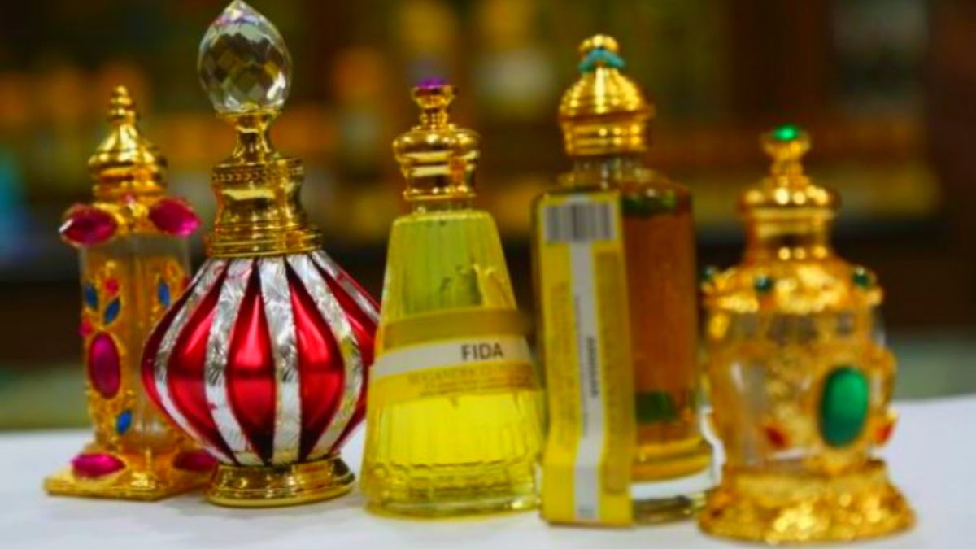

Slide 3
A brief Historical backdrop
Commonly known as attar or itra, these aromatic compounds are the extractions of the flowers, herbs, spices, sandalwood/ agar wood etc in the base oils.
The technique of hydro-distillation used in the processing of these attar or itra is believed to be introduced by Mughal Nobles during 17th Century AD in India.
Attar or itra are basically non-alcoholic floral extract used as natural perfumes, world-wide.

Slide 4
Perfumery industry in kannauj
There are total of about 973 firms registered under GST Act,2017 in Kannauj.
Out of which 662 registered persons are manufacturers and rest 311 are traders of perfumery and its compounds.

Slide 5
State vs Central jurisdiction

Slide 6
Size of perfumery industry in kannauj
As per FY 2022-23 data:
Total declared Turnover- Rs. 623.73 Cr.
Tax liability of SGST- Rs. 24.27 Cr.
Tax liability of CGST- Rs. 24.27 Cr.
Tax liability of IGST- Rs. 37.30 Cr.

Slide 7
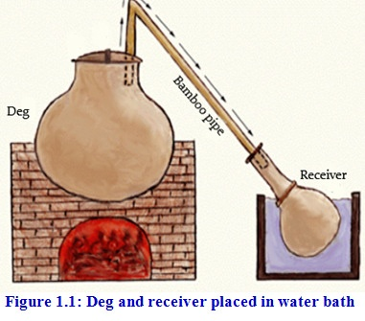
Process of itra extraction in brief

Slide 8
Process of itra extraction in brief…contd.
Initially, the material whose essence is to be extracted is put in the Deg. Water is added to the Deg.
The Deg is sealed from the top using Multani Mitti and firewood is set on fire to heat it and thus, start the process of distillation.
The process of flower distillation takes a maximum of seven hours (just for one kind of flower fragrance) and that of Heena and Herbs takes around 12-18 hours.
This industry has very little wastage. The floral parts which are left after the process of distillation are used to make agarbattis.

Slide 9
Process of itra extraction in brief…contd.
The very same equipment is used to produce what is called a "ruh". The only difference in the procedure is that the receiving vessel holds no sandalwood oil. The bamboo pipe connecting the Deg to the Bhapka (reciever) is also longer. In this way pure Khus oil is made.

Slide 10
Raw Materials
Base Material: Sandalwood oil, Di-Octyl Phthalate (DOP) and Liquid paraffin. Main suppliers- Sandal Wood Oil: Karnataka, Andhra, T.N.
Floral Material: Flowers of Gulab, Kewra, Bela, Mehndi, Kadam, Chameli, Marigold, Saffron. Industries collect fresh flowers from a 30 km radius of the city. Main suppliers- Aligarh (Uttar Pradesh), Palampur (Himachal Pradesh), Kewra: Ganjam (Odisha)
Herb and Spices: Oakmoss, Sugandh mantri, Daru Haldi, Javattari/ Jaiphal, Cardamom, Clove, Saffron, Ambergris and Musk. Main suppliers-North-East, South India, Madhya Pradesh, Saffron: Jammu and Kashmir. Nagarmotha: Odisha, MP & WB

Slide 11
SALE
Final Product sale Ratio
      B2B -99%
      B2C -01%

Slide 12
Main recipients
Pan Masala manufacturers.
Export (Foreign buyers).
FMCG: for use in toileteries by FMCG giants like P&G, Emami, HUL etc- Poojan Samagrees like-Agarbatti, Dhoopbatti, Hawan Samigree.
Domestic retail purchasers.
Chemists/ Medicinal use (Like Dabur and Patanjali).

Slide 13
Modes Of Supply & Transportation
Road (Cars, Buses etc)
Courier
Air Shift

Slide 14
Packing Material
Glass bottle from Firozabad, Delhi, Mumbai & Singapore
Corrugated Boxes from Kanpur, Noida & Kannauj

Slide 15
Rate Of Tax
HSN Code : 3301 GST Rate :18%
Essential Oils (Whether Terpeneless or not), includes Absolutes and Concretes, Extracted Oleoresins, Resinoids, or Fats of Essential Oil in the concentrated form obtained via Enfleurage or Maceration
HSN Code: 3302 GST Rate :18%
Mixtures Of Odoriferous Substances And Mixtures (Including Alcoholic Solutions) With A Basis Of One Or More Of These Substances, Of A Kind Used As Raw Materials In Industry
HSN Code : 3303 GST Rate :18%
Toiletries and Perfumes
HSN Code : 3307 GST Rate :5%
Agarbatti

Slide 16
ISSUES encountering…
Transportation of finished products mainly through buses, cars and two wheelers often with family members including ladies.
High value itra transportation through luxury cars.
Undervaluation is quite rampant in this industry.
Valuation is quite difficult as chemical composition of products can not be identified easily.
During search proceedings also problems are there regarding identification and valuation of raw materials, semi finished and final products.

Slide 17
Suggestions to curb tax evasion
At sector level regular monitoring of returns and dealer analysis is needed. Availed and utilized ITC also to be verified.
At SIB level solid intelligence network and regular analysis of dealers and thereafter exemplary search proceedings stock taking and valuation being the most important aspect.
At Mobile Squad level local intelligence about movement of goods and collection of bills on large scale. Also passing of vital inputs to SIB unit.

Slide 18
THANK YOU !

