Slide 1
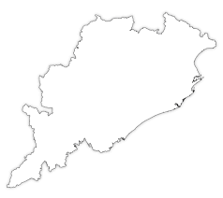

Best Practices of
Commissionerate of CT & GST, Odisha
Finance Department
Commissionerate of CT & GST, Odisha

Slide 2

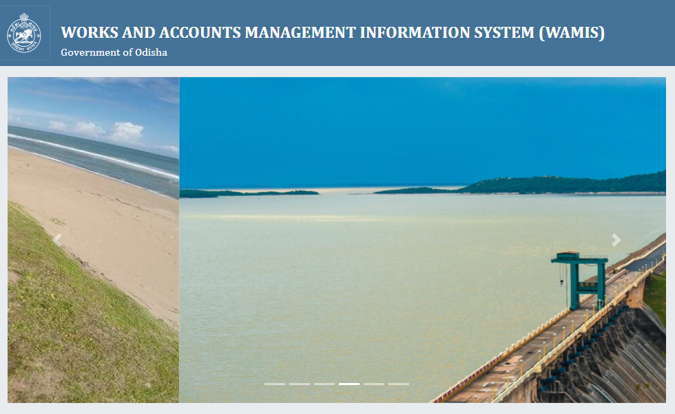
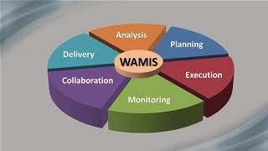
Odisha State GST: System Integration for Data analytics from Engineering Department (WAMIS)
Data relating to works expenditure of Government (i.e. payment to Works contractors) is obtained from the fully automated system called WAMIS (Works and Accounts Management Information System) on annual basis.
The information filed by these works contractors in their GST Returns is cross-examined with WAMIS data to detect defaulters, who are:
  Non-Filers;
  NIL Filers; and
  Under-reporting their Tax liability
Accordingly, action is taken against such defaulters for collection of due revenue.
The WAMIS data relating to works contractors/ Taxpayers who are assigned under Central Tax Authorities, is also shared with central counterpart.
Similar action is also taken by the Central counterpart against such defaulters under their jurisdiction

Slide 3
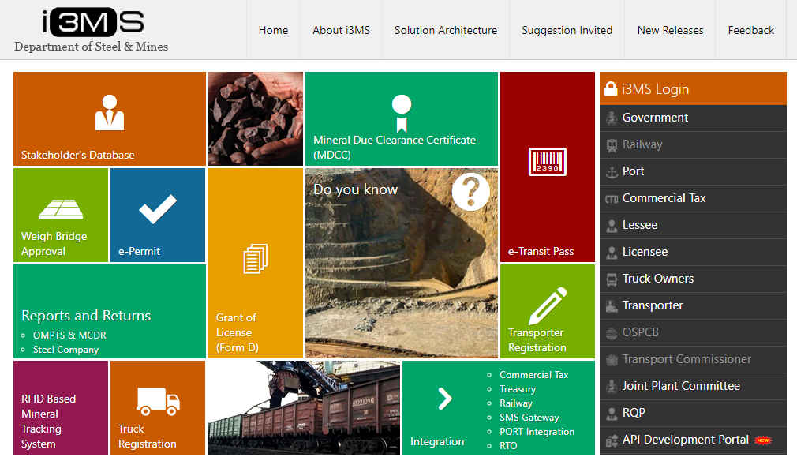
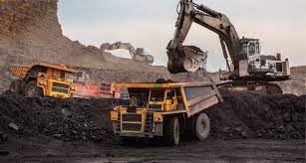
Odisha State GST: System Integration (Mining Data Integration)
Odisha is endowed with about one third of the estimated national mineral resources, which is a major contributor of revenue in the State in form of GST on payment of royalty on mining lease.
Like WAMIS, i3MS is a State-owned ERP System, which facilitates tracking of end to end mineral transaction including payments.
The field formations under State GST Authorities have been instructed to cross-check the payment made by mining lessees with the data from i3MS to ensure that all the Lessee/Licensee in the State are declaring correct information before the Mining Authority and GST authority.
The Treasury run Integrated Financial Management System, Odisha provides the details of payment of mining royalty, which is cross verified to ascertain the correctness of information provided in the GST returns.
Steps are also being taken for integration with i3MS, for setting up of an automated process of such cross-verification and generation of reports relating to deviations, if any.

Slide 4
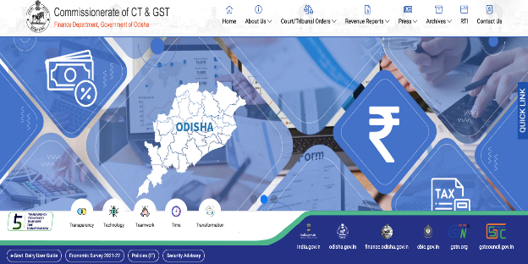
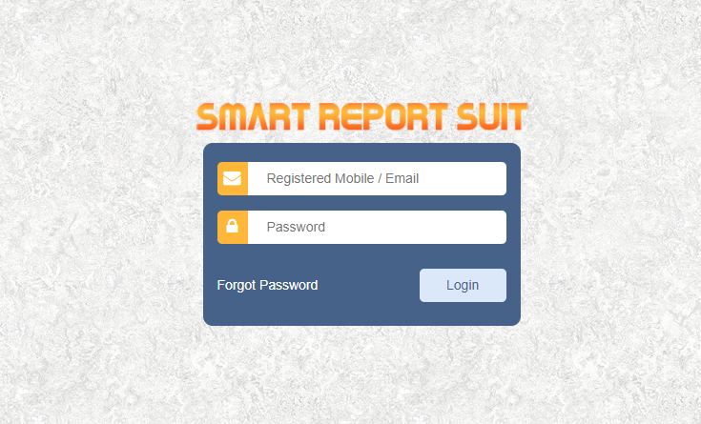

Odisha State GST: Monitoring (Smart Suit)
The Red Fag Reports received from GSTN are further filtered to prirotise high-stake and low hanging cases and those are shared with the field formation for focused action.
A simple monitoring tool, called “Smart Report Suit” is developed in-house, to monitor the progress of action taken in these cases at each stage:
  assignment of case → issuance of notices → determination of tax → recovery of GST Dues
It is an effective tool for monitoring of work of the field functionaries by the Commissionerate.
The progress of action taken in these cases are regularly monitored by the Chief Commissioner to ensure timely disposal and collection of demands, as the case may be.

Slide 5

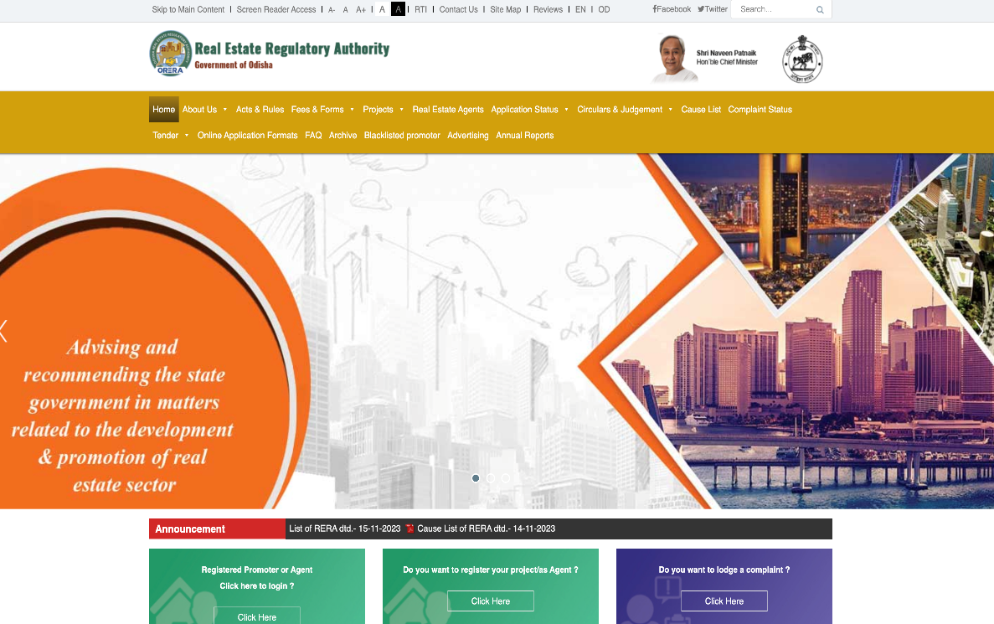
Odisha State GST: Information from ORERA
A data repository of Real Estate Projects (ongoing and completed) is prepared to verify the status of registration of all Real Estate Agents and Developers in the State.
The data is taken from the Real Estate Regulatory Authority and Municipalities
Information is also obtained information from Inspector General of Registration (IGR), Odisha
These information are used to cross-examine the status of registration of the Real Estate Agents and Developers as well as their tax compliance.

Slide 6


Odisha State GST: Bogus Invoicing in Service Sectors
  Verification of BIG Inter-state transactions
Identification of Bogus transaction in service sector
Identification of Suppliers who are providing service to Government Corporation/Government Entities but showing the transactions as exempted.
Action against the taxpayers availing refund of ITC on account of Inverted Duty Structure by ratio analysis and based on Technical Report from CSIR-IMMT (Research Lab of GoI) (Fly Ash Bricks)

Slide 7
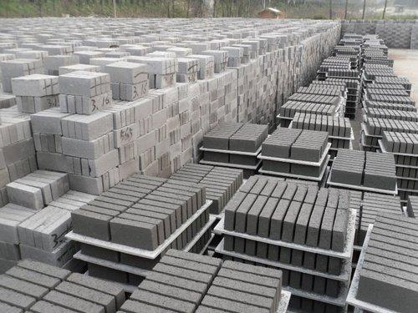

Odisha State GST: Refund of ITC on account of IDS – Case Study
  A Taxpayer was availing refund of ITC on account of Inverted Duty Structure on manufacturing and selling of Fly ash bricks by arranging Invoice for purchase of cement.
  He was also engaged in trading of cement. With the help of his buyers, he manages to covert all B2C sale of Cement of his buyers to B2B sale in his name.
  On analysis of purchase disclosed in Annexure-B uploaded with the Refund Application, it was found that the taxpayers was showing substantially bogus purchase of cements to claim refund of ITC on account of IDS.
  With the help of CSIR-IMMT (Research Lab of Govt.), we established tax evasion of Rs. 28 Crores in that case. Based on the said report, we are analyzing IDS Refund on fly ash bricks for the entire state.

Slide 8


Odisha State GST: Taxpayer facilitation measure (Mo Sarkar)
One of the key aspects of tax administration is grievance management.
Government of Odisha has set up the “MO SARKAR” initiative to address the grievances of the citizens in the State, which provides for a Centralized Portal for Visitors Management.
The facility provided by the “MO SARKAR” initiative is extended to all the taxpayers in the State by way of setting up of “Mo Sarkar Cells” in all field offices including the Commissionerate for grievance redressal of the Taxpayers.
The action taken by the State GST Offices is reviewed by Senior Officers on regular basis to ensure timely redressal of the Grievances by the State GST Offices.
Senior officers of the Commissionerate are making feedback calls to ensure satisfactory redressal of the grievances of the taxpayers.
In addition, an exclusive online Grievance Redressal System for the Taxpayers is being developed for the CT & GST Organization.

Slide 9
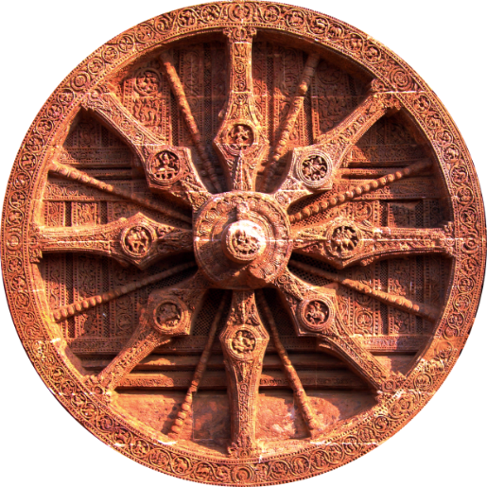
THANK YOU
Commissionerate of CT & GST, Odisha, Cuttack
https://odishatax.gov.in

